Slide 1
Operational Transconductance Amplifier (OTA) in 45nm CMOS
YOUNGSEOK LEE
Ming Hsieh Department of Electrical Engineering
University of Southern California, Los Angeles, CA 90089

Slide 2
Remark
Incompletion of Test measurements
Plotting works in slides are in low quality.

Slide 3
Outline
1. Introduction
2. Design Summary
3. Simulation and Analytical Results
4. Conclusions

Slide 4
[1] Introduction - 1
1. Statement of the problem
Designing a fully differential OTA to meet the required spec
2. Main challenges
Low Vdd : Overdrive Voltage Budget Issue
45nm technology : Biasing issue
Large GBW product

Slide 5
[1] Introduction - 2
3. General approach
- Characterize the device
- Select a topology based on the required spec
- Bias and Size accordingly
- Tune the circuit for better performance

Slide 6
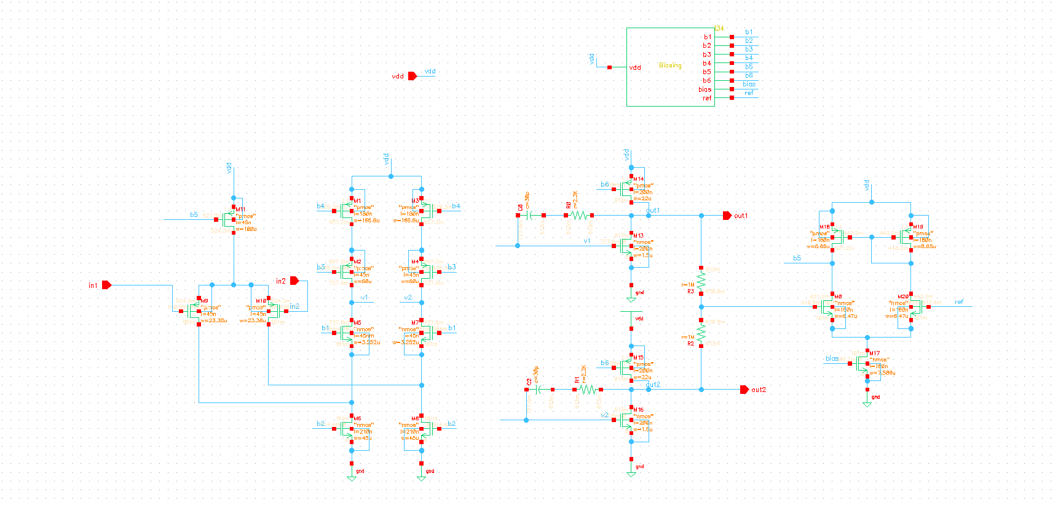
[2] Design Summary - Overview

Slide 7
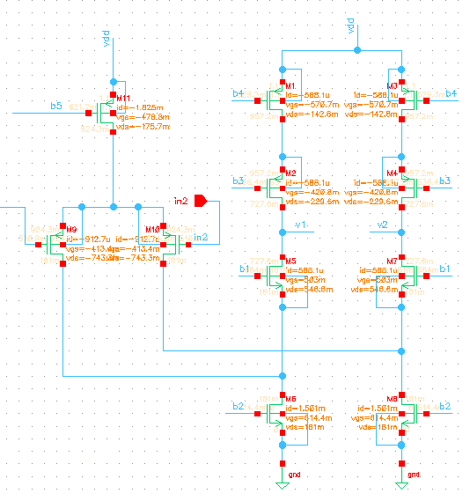
[2] Design Summary – DC operating points(1)

Slide 8
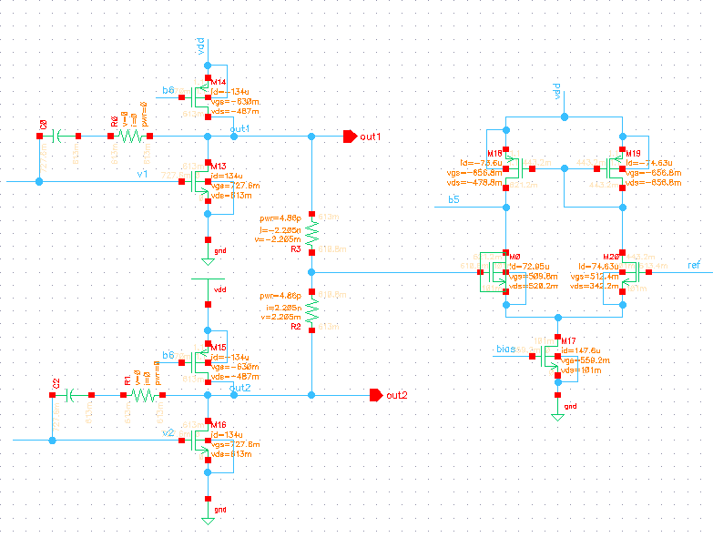
[2] Design Summary – DC operating points(2)

Slide 9
[2] Design Summary – Device Sizing
Transistors | W/L | Transistors | W/L | Transistors | W/L
M1 | 166.8u/180n | M8 | 45u/210n | M16 | 1.5u/200n
M2 | 60u/45n | M9 | 23.38u/45n | M17 | 7.586u/180n
M3 | 166.8u/180n | M10 | 23.38u/45n | M18 | 8.65u/180n
M4 | 60u/45n | M11 | 100u/45n | M19 | 8.65u/180n
M5 | 3.252u/45n | M13 | 1.5u/200n | M20 | 6.47u/180n
M6 | 45u/210n | M14 | 22u/200n | M0 | 6.47u/180n
M7 | 3.252u/45n | M15 | 22u/200n

Slide 10
Design Strategy
Two stages Folded Cascode Structure
Frequency Compensation
Common Mode Feedback circuitry
(2) Design Methdology
Overdrive Voltage Budget Plan
Sizing independent Biasing Method
Gain boosting ideas

Slide 11
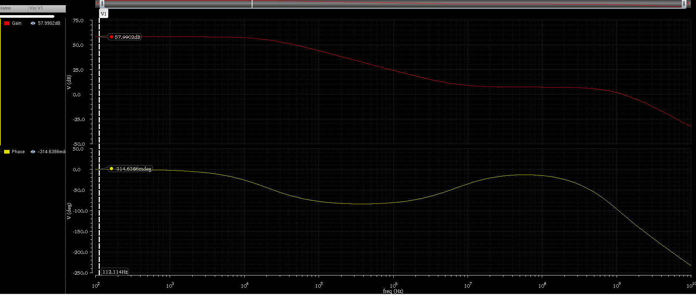
[3] Simulation Result – Closed loop gain 58 dB

Slide 12
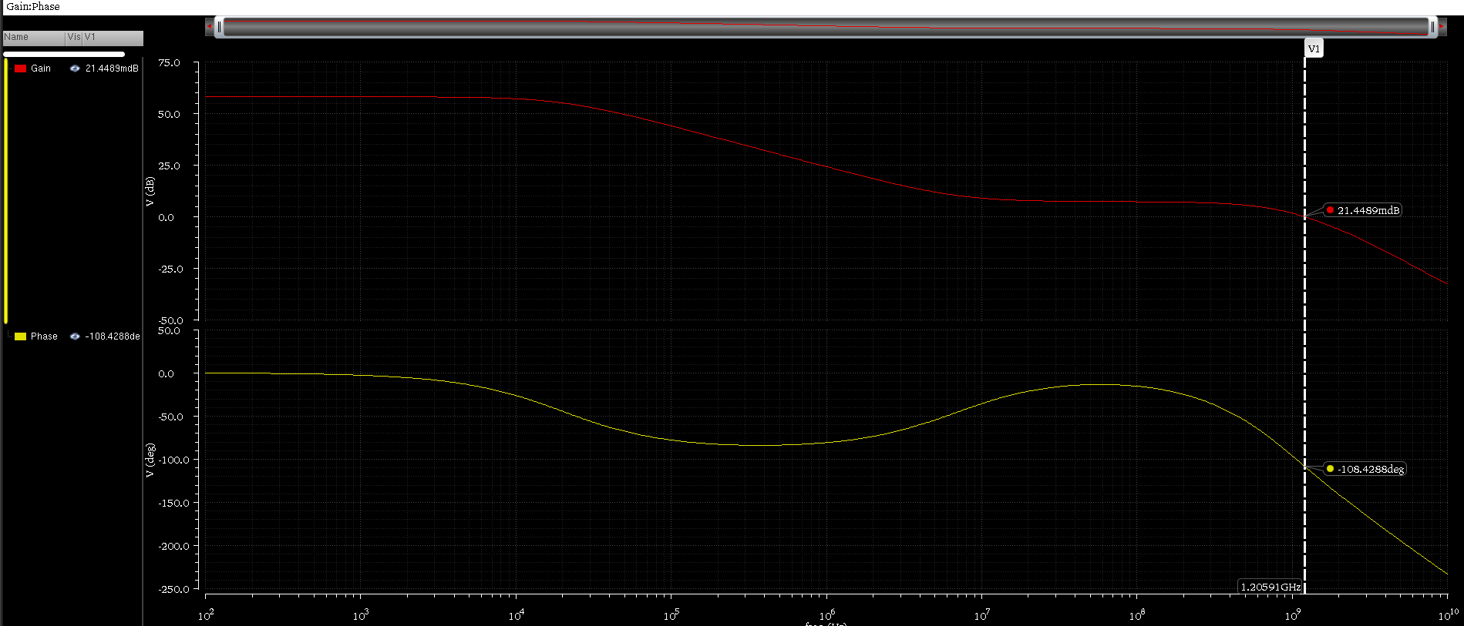
[3] Phase Margin – Closed ; 72dB

Slide 13
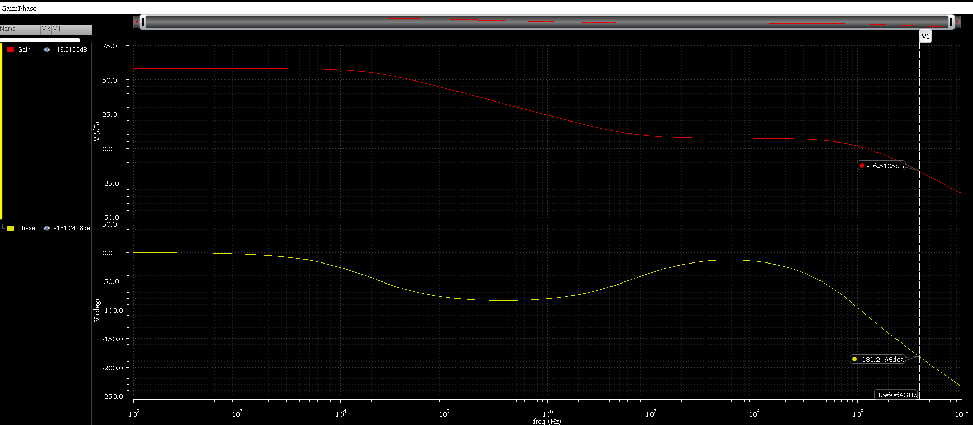
[3] Gain Margin – Closed ; 16dB

Slide 14
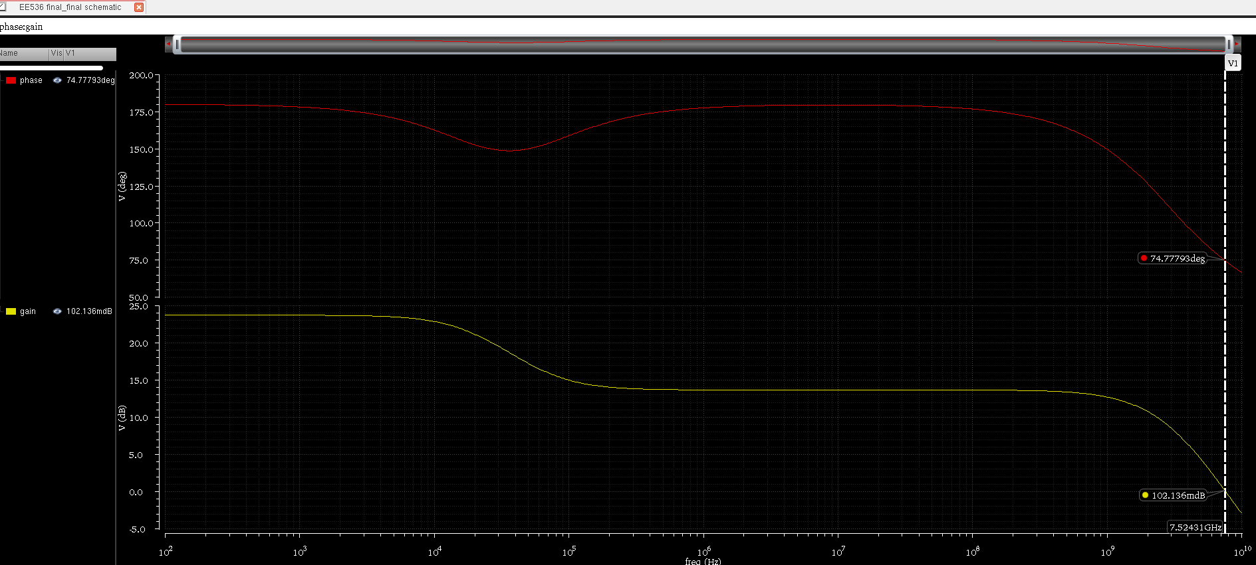
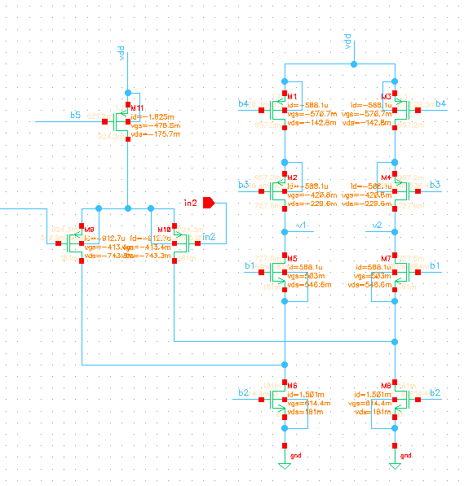
[3] First Stage : Gain 23dB, Fu=7.5GHz

Slide 15
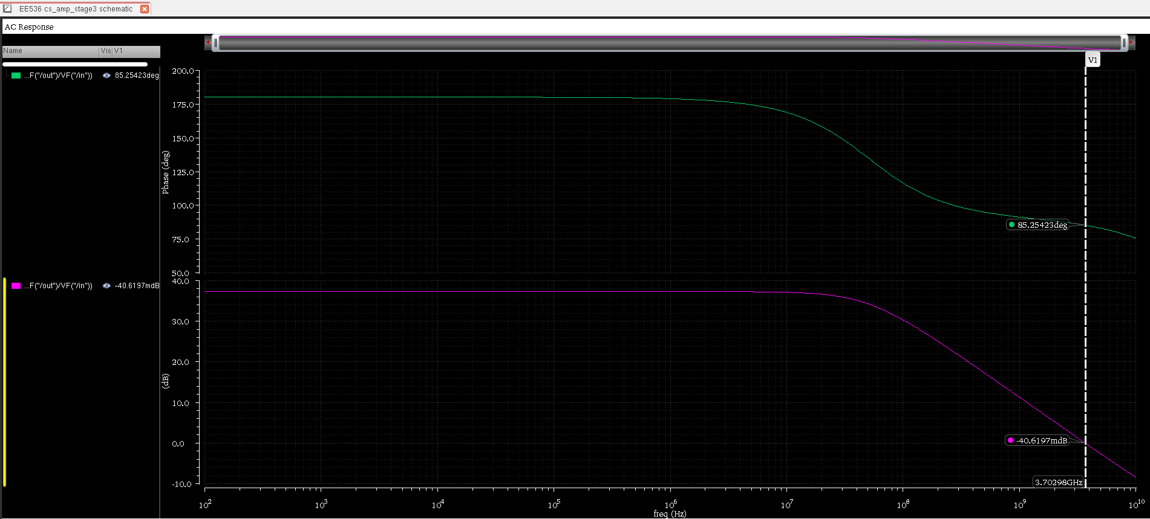
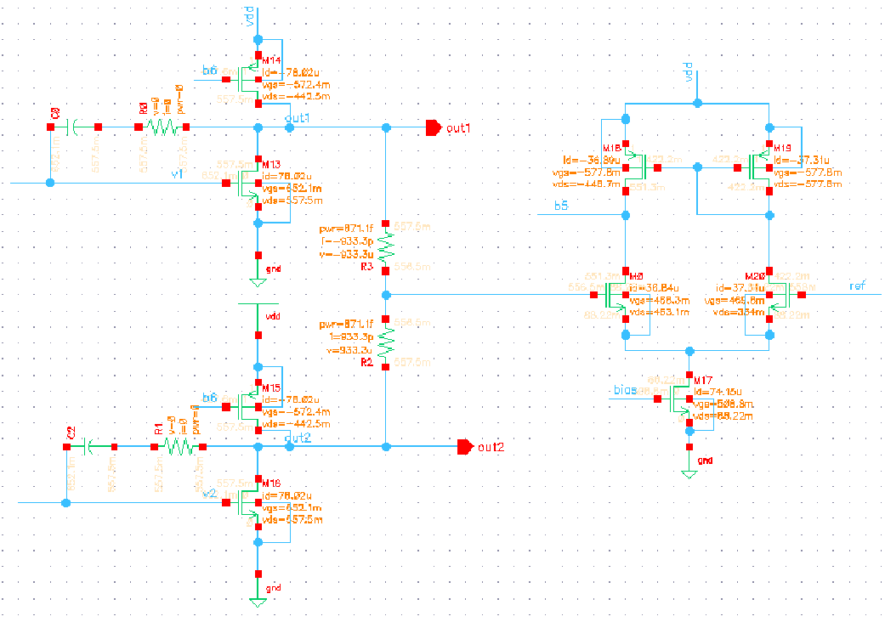
[3] Second Stage : Gain 37dB, Fu=3.6GHz

Slide 16
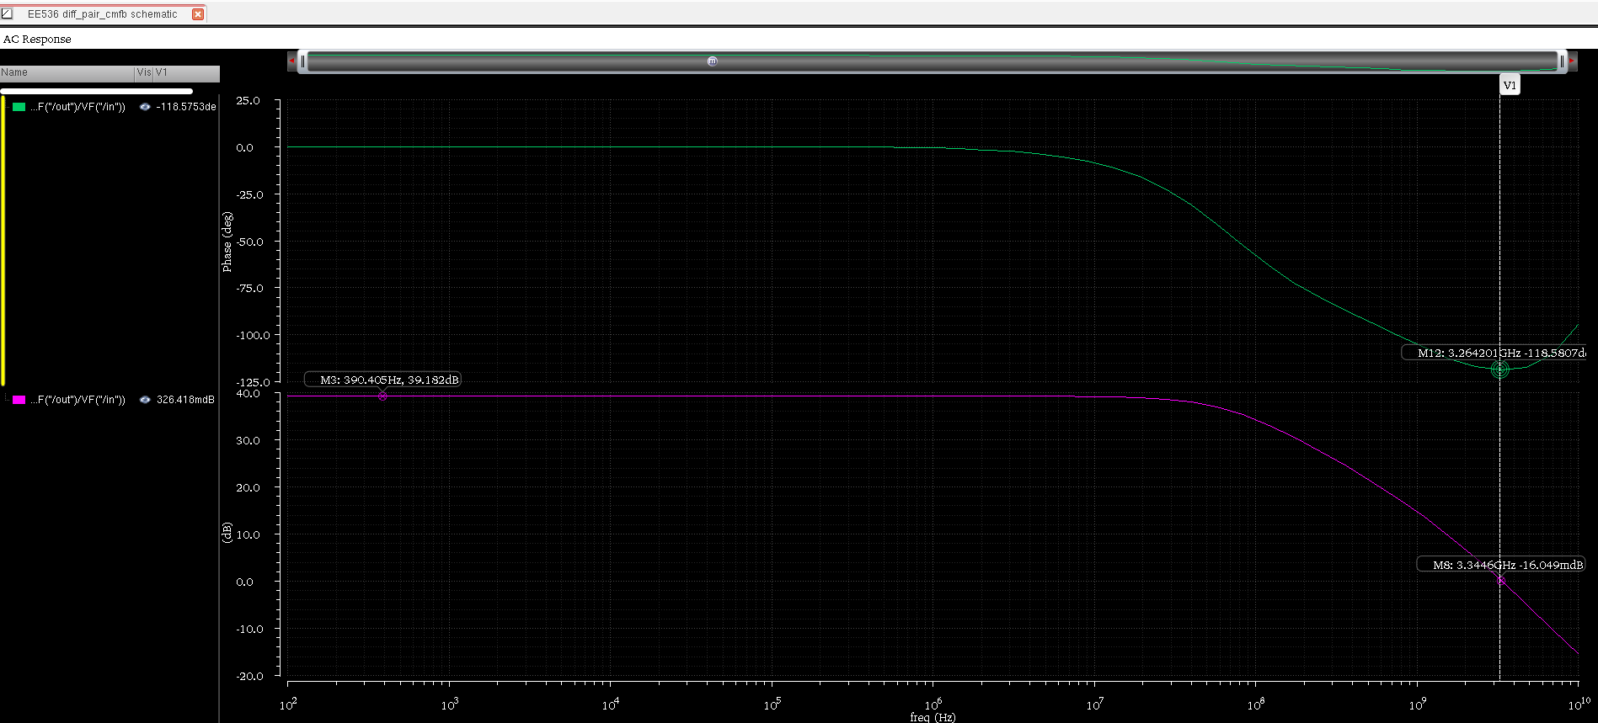
[3] CMFB Small-Signal Response

Slide 17
[3] Performance Summary
 | Target | Simulated | Units
I A_{vd} I | > 60 | 58 | dB
F_{u} | > 100 | 1.2 | GHz
V_{dd} | 1 | 1 | V
I_{DC} | < 25 | 1.96 | mA
C_{L} | 100 | 100 | fF
PM | > 60 | 72 | Degrees
GM | > 10 | 16.5 | dB

Slide 18
[4] Conclusions (1)
1. Highlights of the design
- Folded Cascoded Two stage OTA
- Good performance in gain and bandwidth product
2. Improved Suggestion
- Regulated cascodes can be utilized

Slide 19
[4] Conclusions (2)
3. Lessons learned
- Analog Design brings a lot of result mismatch
- Balancing all transistors whose characteristics are nonlinear requires much more efforts beyond the its relatively simple analysis

Slide 20
References
[1] B. Razavi, Design of Analog CMOS Integrated Circuits. McGraw-Hill, 2002.
[2] B. Ahuja, “An improved frequency compensation technique for CMOS operational amplifiers,” IEEE J. Solid- State Circuits, Vol. SC-18, pp. 629-633, Dec, 1983.
[3] F. Silveira, “A gm/Id Based Methodology for the Design of CMOS Analog Circuits and Its Application to the Synthesis of a Silicon-on-Insulator Micropower OTA, IEEE J. Solid-State, VOL 31, NO 9. Sep, 1996

